Slide 1

Web Development-2
Introduction to client server model and javascript.

Slide 2
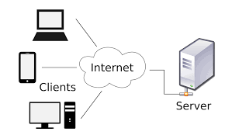
Client Server Model
Introduction to Backend Development

Slide 3



Jokes
I want Jokes

Slide 4






Jokes
Books
DNS
DNS
Recipes
I want Jokes

Slide 5

Jokes
Books
192.105.232.4
DNS
DNS
Recipes
where is Jokes.com ?

Slide 6


Jokes
Books
DNS
DNS
Recipes
Yes now I Know
Where to get jokes

Slide 7







Slide 8
Jokes
Books
DNS
DNS
Recipes

Slide 9














